Slide 1
an International CBSE Finger Print School
Coimbatore
SUBJECT NAME - 041 MATHEMATICS
GRADE-XI
UNIT – 5
TOPIC – COMPLEX NUMBERS AND QUADRATIC EQUATIONS

Slide 2
COMPLEX NUMBERS AND QUADRATIC EQUATIONS
Why Complex numbers are introduced?
Let us take one example from class X,
Solutions of the quadratic equation 𝒙^{𝟐} + 1 = 0 is
𝒙^{𝟐} = -1 = x = ± -1 which is not real roots,
That is, the roots of the quadratic equation are imaginary.
Such numbers are called complex numbers.

Slide 3
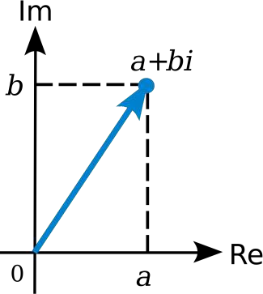
What is Complex Number?
Complex Number is an algebraic expression including the factor i = √-1.
These numbers have two parts, one is called as the real part and is denoted by Re(z) .
And the other part is called as the Imaginary Part and it is denoted by
Im(z) for the complex number represented by ‘z’ which is a + ib.
Complex numbers extended the idea of one
dimensional number line to the two dimensional complex plane by using horizontal line [X-axis] as real axis and vertical line [y- axis] as imaginary or complex axis.

Slide 4
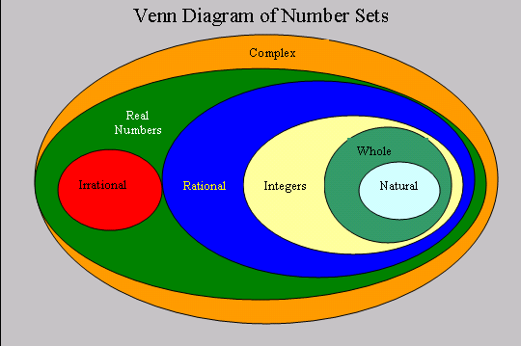
If b=0, the complex number z = a + ib reduces to a which is a pure real number.
If a = 0, the complex number z = a + ib reduces to bi which is a purely imaginary number.
In other words all numbers, real imaginary are in the set of complex numbers.
ALL REAL NUMBERS ARE ALSO COMPLEX NUMBERS
WITH IMAGINARY PART ‘0’

Slide 5
Algebra of Complex Numbers
Addition & Subtraction of two complex numbers:-
Let z₁ = a + ib and z₂ = c + id be any two complex numbers.
Then, the sum z₁ + z₂ is defined as follows:
z₁ + z₂ = (a + c) + i (b + d), which is again a complex number.
And the the difference is defined as:
z₁ - z₂ = (a - c) + i (b - d), which is again a complex number.
For example,
(2 + i3) + (– 6 +i5) = (2 – 6) + i (3 + 5) = – 4 + i 8
(2 + i3) - (– 6 +i5) = [2 –( – 6)] + i (3 - 5) = –8 - i 2

Slide 6
Equal Complex numbers:-
If two complex numbers are equal then their real parts are equal and their imaginary parts are also equal.
i.e., a + ib = c + id = a = c and b = d
Multiplication of two complex numbers
Let z₁ = a + i b and z₂ = c + i d be any two complex numbers.
Example:- Multiply 3 + 2i and 4 + 5i
Multiplication of two complex numbers is nothing but z₁ × z₂
z₁ × z₂ = (a + i b) × (c + i d)
= ac+iad+ibc+(ib)(id)
= ac+i(bc+ad)+(-1)(bd)
= (ac–bd) + i(bc+ad)
If z₁ = 3 + 2i , z₂ = 4 + 5i , then
z₁ × z₂ = (3 + 2i ) × (4 + 5i )
= (3×4–2×5)+i(3×5+2×4)
= 12 – 10 + i( 15 + 8)
= 2 + i 23

Slide 7
The addition of complex numbers satisfy the following properties
1.The closure law:-
complex numbers is a
The sum of two complex number,
i.e., z₁ + z₂ is a complex number for all
complex numbers z₁ and z₂.
2. The commutative law:-
For any two complex numbers z₁
and z₂,
z₁ + z₂ = z₂ + z₁
3. The associative law:-
For any three complex numbers z₁, z₂, z₃, ( z₁ + z₂) + z₃ = z₁ + (z₂ + z₃).

Slide 8
4. The existence of additive identity:- There exists the complex number 0 + i 0 (denoted as 0), called the additive identity or the zero complex .
1.The existence of additive inverse:-
To every complex number z = a + ib, we have the complex number
– a + i(– b) (denoted as – z), called the additive inverse or negative of
z. We observe that z + (–z) = 0 (the additive identity).
2. The existence of multiplicative identity:-
There exists the complex number 1 + i 0 (denoted as 1), called the
multiplicative identity such that z × 1 = z, for every complex no. z. Hence 1 is the multiplicative identity of a complex number.

Slide 9
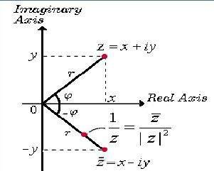
Multiplicative inverse of z = a + ib

Slide 10
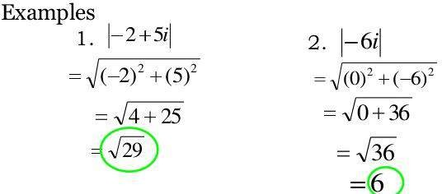
Modulus /Absolute value of a Complex Number
i - imaginary
a)
5
|3 + 4i| =
b)
13
|5 – 12i| =
c)
10
|6 – 8i| =
|-24 – 10i| =
d)
26

Slide 11
i = √-1

Slide 13
Argand Diagram
Complex numbers can be shown Geometrically on an Argand diagram
The real part of the number is represented on the x-axis and the imaginary part on the y.
-3
-4i
3 + 2i
2 – 2i
Im
Re

Slide 14
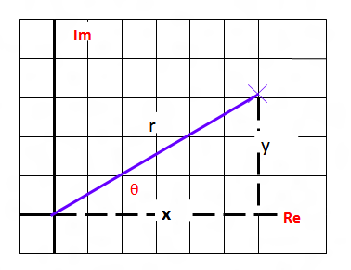
ARGUMENT OF A COMPLEX NUMBER
is the angle of the line makes with the positive direction of x axis.
For any complex number z ≠ 0, there corresponds only one value of θ in 0 ≤ θ < 2π.
However, any other interval of length 2π, for example – π < θ ≤ π, can be such an interval.
We shall take the value of θ such that – π < θ ≤ π, called principal argument of z and is denoted by arg z.

Slide 17
Let us consider the following quadratic equation
ax² + bx + c = 0 with real coefficients a, b, c and a ≠ 0.
Also, let us assume that the b² – 4ac < 0.
Now, we know that we can find the square root of negative real numbers in the set of complex numbers.
Therefore, the solutions to the above equation are available in the set of complex numbers which are given by using the formula.

Slide 18
SOME IMPORTANT PROPERTIES OF IOTA (i)
Sum of any four consecutive integral power of 'i' is zer0(=0)
Product of any four consecutive integral powers of 'i' is - 1 .
i⁰ + i¹ + i² + i³ = 0.
For, i⁰ + i¹ + i² + i³ = 1 + i - 1 - i
= 0.
i⁰ × i¹ × i² × i³ = 0.
For, i⁰ × i¹ × i² × i³ = 1 × i ×(- 1)×( - i)
= i²
= - 1 .

Slide 19
Questions:
If 4x + i(3x – y) = 3 + i (– 6), where x and y are real numbers, then find the values of x and y.
Express the following in the form of a + bi:
Find the multiplicative inverse of 2 – 3i.

Slide 20
References
https://schools.aglasem.com/ncert-books-class-11-maths-chapter-5/
https://dpsguwahati.org/hw%2020-21/Maths,Complex%20Numbers%20and%20Quadratic%20Equations,ClassXI.pdf
https://www.tiwariacademy.com/ncert-solutions/class-11/maths/chapter-5/
https://edurev.in/studytube/PPT-Complex-Numbers-Quadratic-Equations/7497391d-c24f-4777-baa5-4cae97446904_p
https://www.slideshare.net/DeepanshuChowdhary/complex-numbers-and-quadratic-equations-58794555

